Slide 1


Lesson 1 你好 Nǐ hǎo
沙茜（shā qiàn ）
沙老师（shā lǎo shī ）
teacher

Slide 2
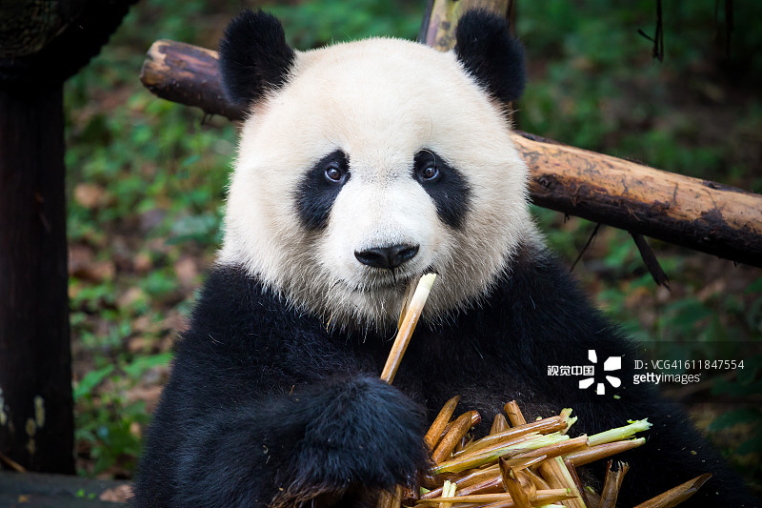



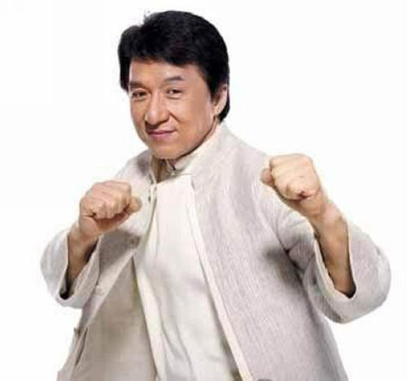

Slide 3

Nǐ hǎo
A: 你 好！ Hello!
Nǐ hǎo
B: 你 好！ Hello!
New Words:
你 nǐ pron. you(singular)
好 hǎo adj. good,fine,nice

Slide 4
拼音pinyin
Pinyin is the Chinese language phonetic system. It is used to mark Mandarin Chinese pronunciation by the Latin alphabet.

Slide 5
The Chinese character 你（you）with Pinyin.
nǐ
你
This is Pinyin.
This is Chinese character.
In Chinese, every character corresponds to single syllable. Therefore, one syllable marks the pronunciation of one character.

Slide 6
Tone
nǐ
Initial
Final
A typical Pinyin syllable consists of three parts: initial, final and tone.

Slide 7

声母 Initials
p
m
f
b
d
t
n
l
ɡ
k
h

Slide 8
Listen and choose
1.A. b B. p
4.A. n B. l
√
√
2.A. m B. f
5.A. ɡ B. k
√
√
3.A.d B. t
6.A. h B. k
√
√

Slide 9
韵母 Finals
ɑ
o
e
i
u
ü
er
ɑi
ei
ɑo
ou
ɑn
en
in
ɑnɡ
enɡ
inɡ
onɡ

Slide 10
Initials+Finals
bɑ
pɑo
mɑi
fɑn
nü
lu
dou
ting
ɡɑnɡ
keng
hong

Slide 11
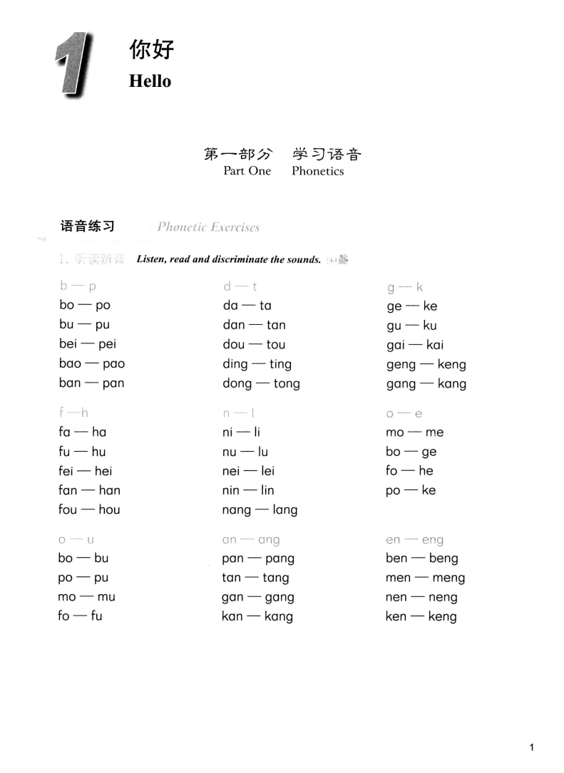
Listen and read

Slide 12
Listen and read

Slide 13
Listen and read

Slide 14
声调tones
ˊ
ā
ˉ
ˇ
ˋ
5
á
4
3
2
ǎ
à
1

Slide 15
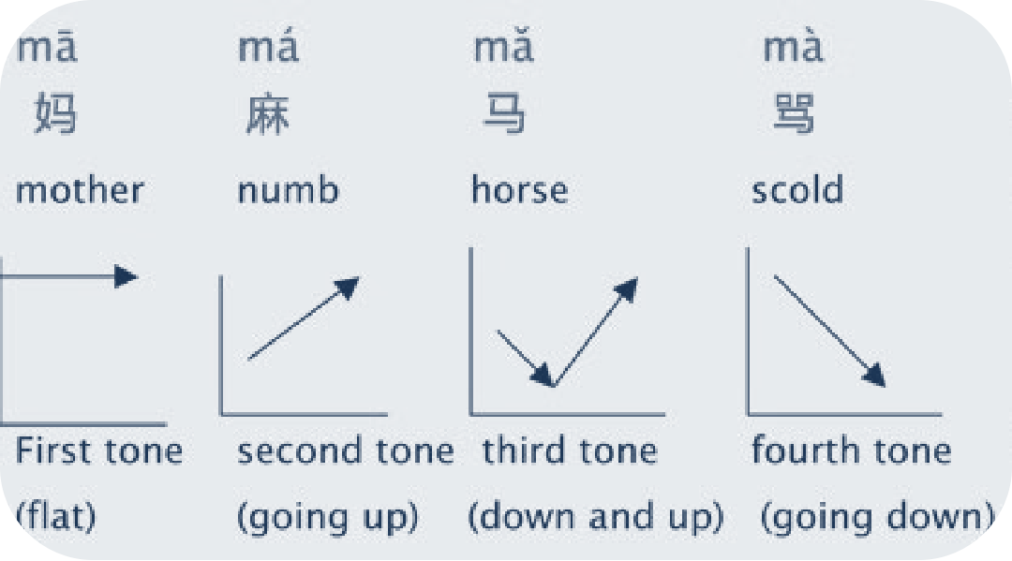
声调tones
Notes:
自我介绍，和学生熟悉一下。

Slide 16
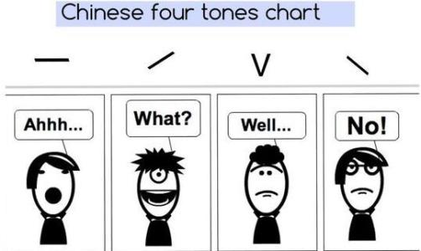

Slide 17
声调tones
ā á ǎ à
ī í ǐ ì
ō ó ǒ ò
ū ú ǔ ù
ē é ě è
ǖ ǘ ǚ ǜ

Slide 18
(Initials)+Finals+tones=syllables
dīng
míng
nǐ
bù
hē
nín
lǐ
èr

Slide 19
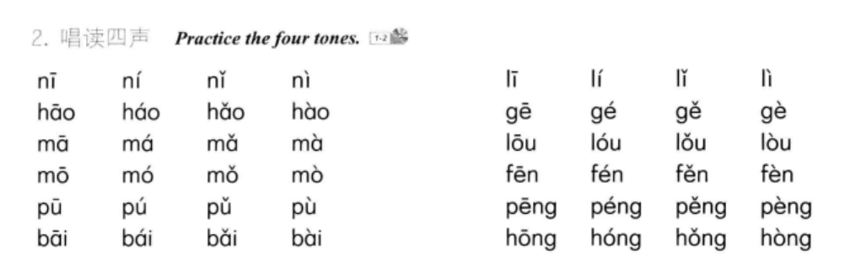

Slide 20
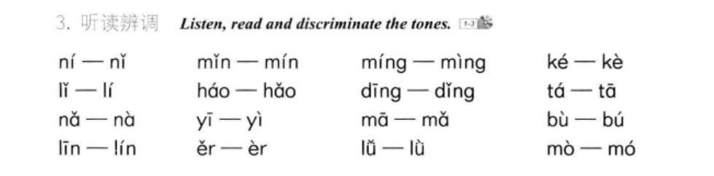

Slide 21
listen and add the tone marks
ma tong lü bai po feng
gu ni ka pei han ding
pò
fēng
mā
tóng
lǜ
bái
gù
kǎ
pèi
hàn
dīng
nǐ

Slide 22

课 文一 Text One
New Words:
你 nǐ pron. you(singular)
好 hǎo adj. good,fine,nice
Proper Names:
马丁 Mǎ dīng Martin, name of an American student
林娜 Lín nà Linna,name of a French student
马丁: 你 好！ Hello!
Mǎ dīng Nǐ hǎo
林娜: 你 好！ Hello!
Lín nà Nǐ hǎo

Slide 23
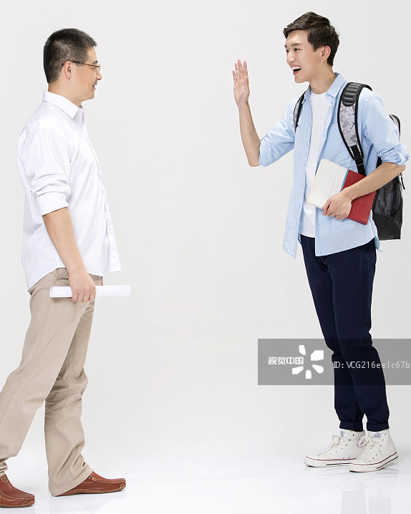
课 文二 Text Two
New Words:
您 nín pron. you (polite singular)
Proper Names:
李一民 Lǐ Yīmín name of a Chinese teacher
2. 阿明 āmíng name of a Thai student
李一民: 你 好！ Hello!
Lǐ Yīmín Nǐ hǎo
阿明: 您 好！ Hello!
āmíng Nín hǎo

Slide 24
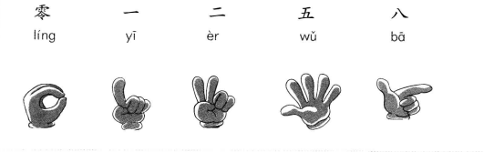
课 文三 Text Three
New Words:
零 líng zero
一 yī one
二 èr two
五 wǔ five
八 bā eight

Slide 25
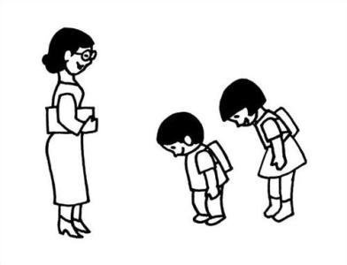
补充生词 Supplementary Vocabulary
New Words:
你们 nǐmen pron. you (plural)
老师 lǎoshī n. teacher
A.B: 老师好！ Hello!
Lǎoshī hǎo
老师: 你们 好！ Hello!
Lǎoshī nǐmen hǎo

Slide 26
The Basic Strokes of Chinese Characters
汉字Chinese characters
Each character consists of various strokes formed by different dots or lines as the basic component.

Slide 27
Basic strokes
héng

Slide 28
Basic strokes
shù

Slide 29
Basic strokes
piě

Slide 30
Basic strokes
nà

Slide 31
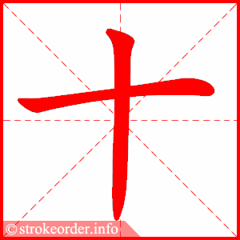
stroke order
1. 先横后竖
“héng” precedes “shù”
shí, ten

Slide 32
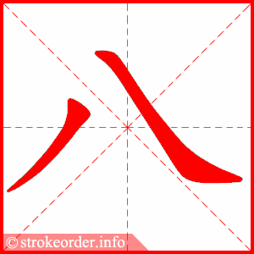
stroke order
2. 先撇后捺
“piě” precedes “nà”
bā eight

Slide 33
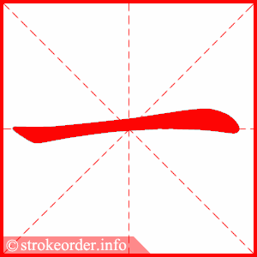
写汉字Chracterwriting
Notes:
http://hsk2020.com/wr?z=%E4%BA%8C

Slide 34
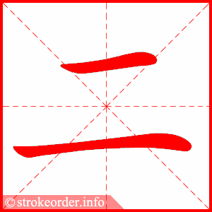
写汉字Chracterwriting
Notes:
http://hsk2020.com/wr?z=%E4%BA%8C

Slide 35
写汉字Chracter Writing
Notes:
http://hsk2020.com/wr?z=%E4%BA%8C

Slide 36
写汉字Chracterwriting
Notes:
http://hsk2020.com/wr?z=%E4%BA%8C

Slide 37
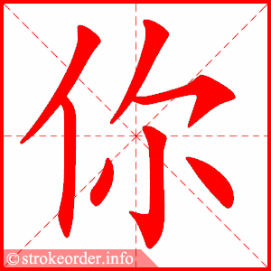
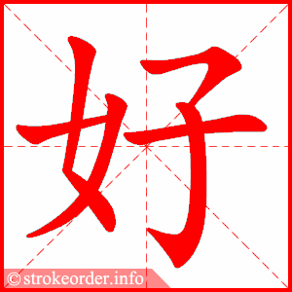

写汉字Chracterwriting
Notes:
http://hsk2020.com/wr?z=%E4%BA%8C

Slide 38
课堂用语 Classroom Expressions
上课！ Class begins!
shàng kè
下课！ Class is over!
xià kè

Slide 39
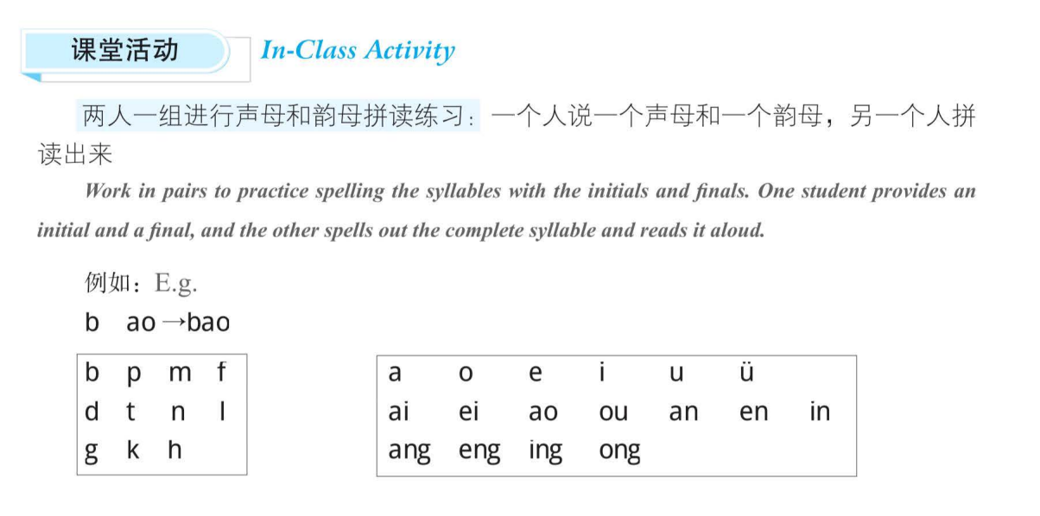
分组练习

Slide 40
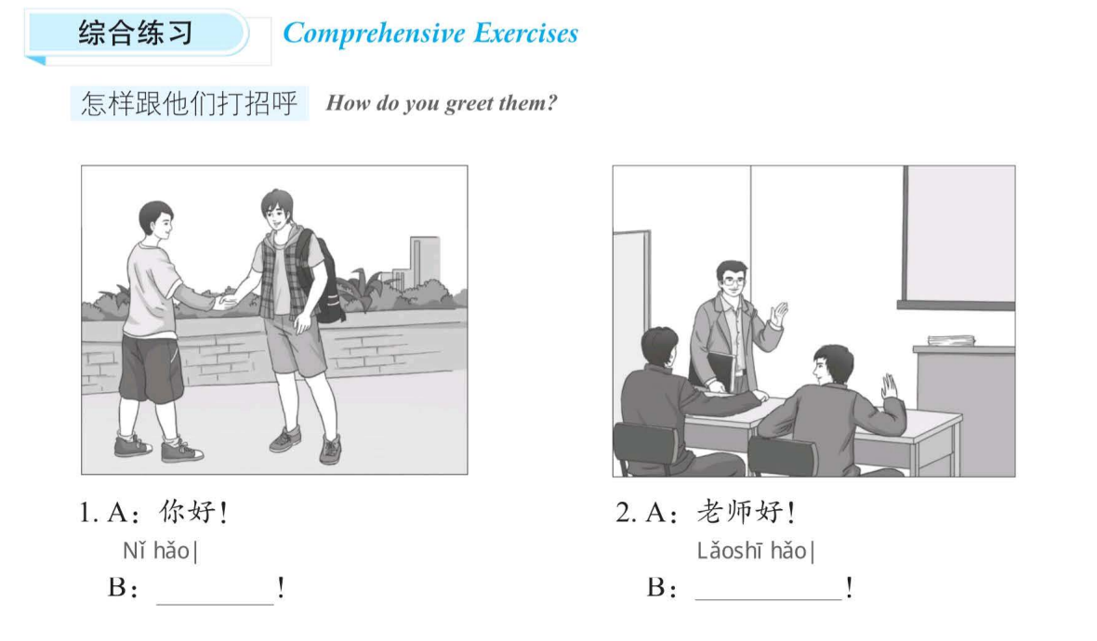
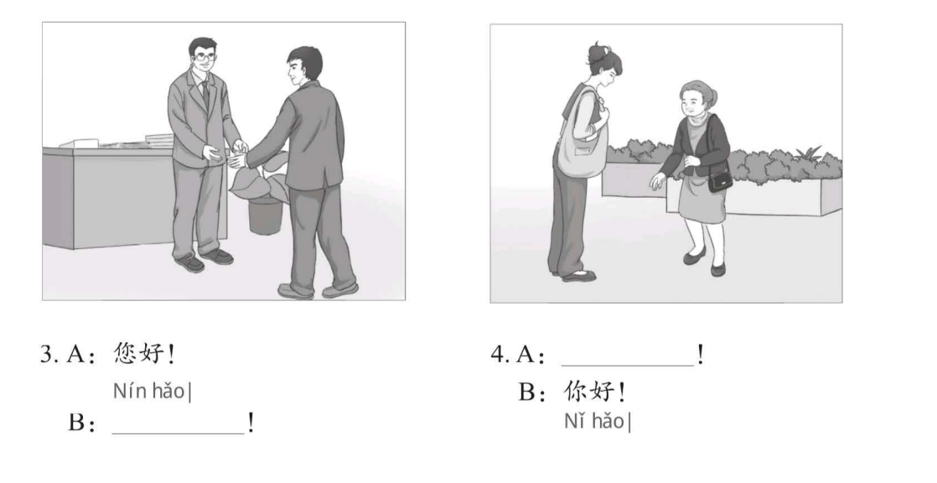
你好
你们好
您好
您好

